Slide 1
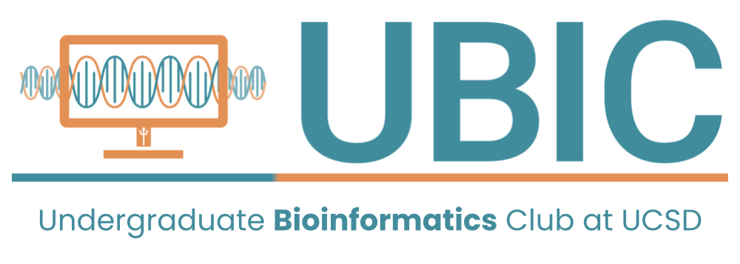
Intro to Bioinformatics
Workshop #1
SIGN IN HERE
Introduce yourself to those around you!
What college are in? What classes are you taking?

Slide 2
Meet the Workshop Committee

Slide 3


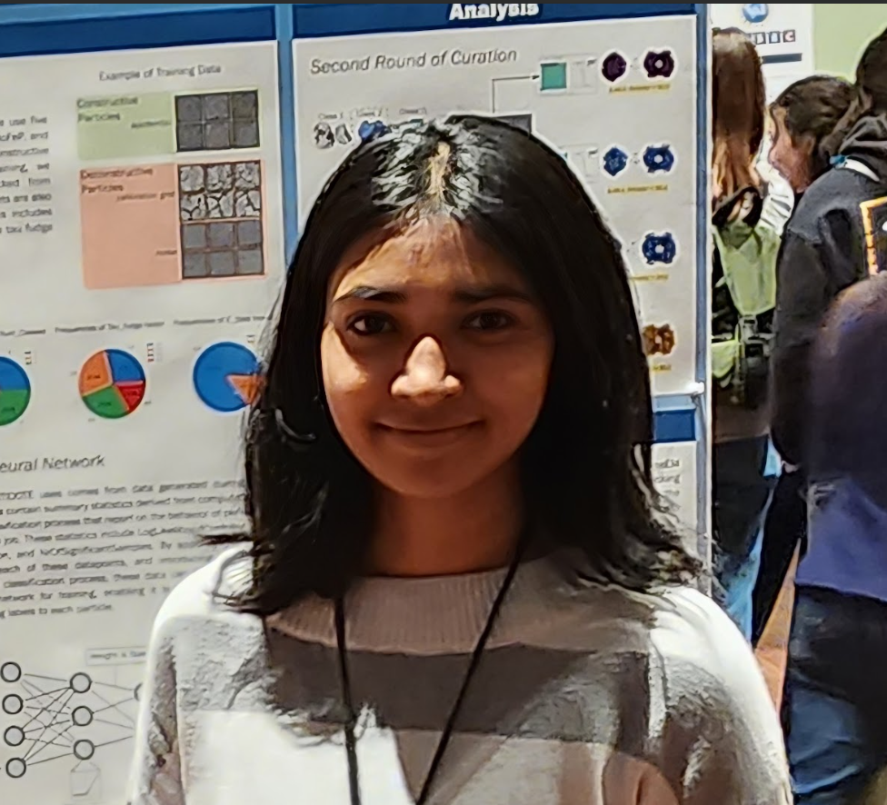
Willard
Megan
Annapurna
Biology: Bioinformatics, Probability and Statistics
Gymrek Lab
wwford@ucsd.edu
Bioengineering: Bioinformatics
Cheng Lab
mec018@ucsd.edu
CS: Bioinformatics
Herzik Lab
asaladi@ucsd.edu

Slide 4
Willard Megan Annapurna
Big foodie & love finding new cafes and restaurants
I enjoy thrifting
Favorite show is Grey’s Anatomy
Enjoy drawing and playing video games, Zelda is my favorite series
Lived in Cali my entire life, I’d like to try visiting other places!
I enjoy Salsa and West Coast Swing dancing
I like insanely long board games with my friends.
I am currently applying PhD programs
Notes:
Maybe include email addresses?

Slide 5
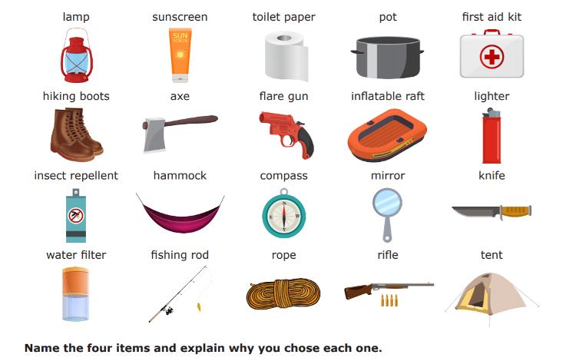
Icebreaker
If you were on a deserted island, what 3 things would you take with you? Debate with a friend!
Notes:
Bad Question Ideas:
What were you doing on July 25th of this year?
2 Truths 1 Lie
What would you do with 1000 elephants?
Good Questions Ideas:
What classes are you taking this quarter?

Slide 6
What is Bioinformatics?
Biology meets Computer Science meets Statistics!
Bioinformatics is an interdisciplinary branch of biology that both creates and uses software to understand large biological datasets and answer interesting questions.

Slide 7
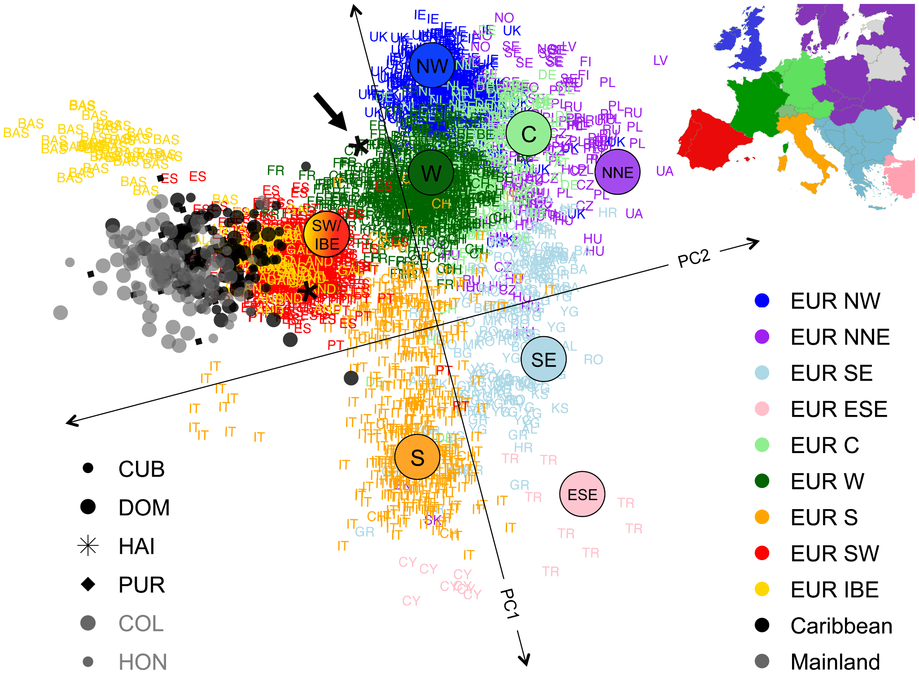
Population Genomics
Moreno-Estrada et al. 2013
Notes:
We’re going to talk about population genomics in the context of Moreno-Estrada et al. A paper looking at Caribbean populations.
Looking at variation within an entire population
We’re not going to talk about all of the details, but we’ll make these slides available afterward for the curious and we’ll happy to answer any questions afterward. The goal here is to just to give you a flavor of a few of the specialties inside bioinformatics.

Slide 8
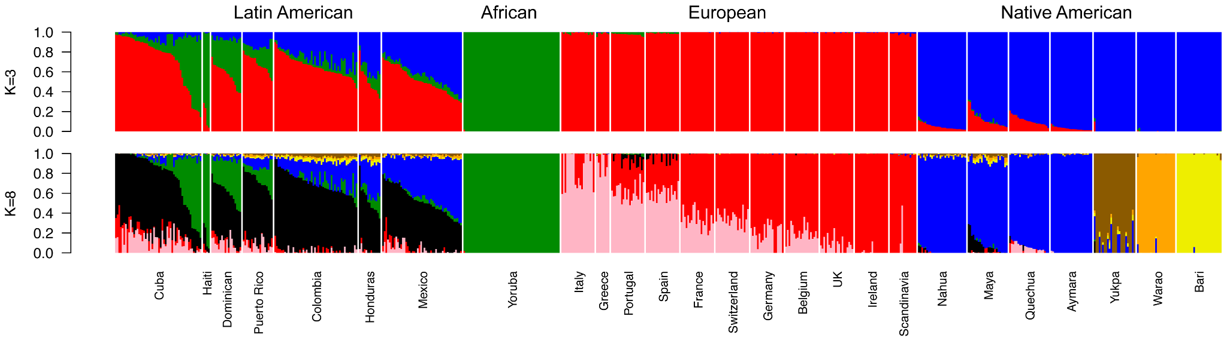
Global Ancestry through admixture
Notes:
Each vertical line represents an individual
Labels at the top are arbitrary
One thing we can do in Population Genetics is to look at global ancestry through admixture. Very few of us are 100% from a single population group, in reality we are all admixed.
In this figure, each color represents an ancestral genome – a genome that no longer exists but represents a population that that many people are descended from. And each column represents an individual.
The top chart represents choosing 3 ancestral genomes, the bottom chart is if we choose 8 ancestral genomes.
Cool facts to point out:
Latin American individuals tend to be descended from both African, European, and Native American ancestral genomes.
The two charts are very different which is why intelligently choosing our parameters and carefully interpreting the results is really important. Bad bioinformaticians can perpetuate harmful stereotypes.
The African population is actually the most diverse but in this dataset you might think the opposite because it is 1 solid color. Choosing your sample is also really important for interpreting the results.
admixture tool is an optimization algorithm: https://github.com/azzaea/admixture

Slide 9
Global Ancestry through Principal Component Analysis (PCA)
Notes:
This is a Principal Component Analysis or PCA Plot
Here each dot represents an individual and they are colored by their population group. In PCA plots individuals who descend from the same ancestral genomes will tend to cluster together.
Cool facts to point out:
The caribbean populations are in grey and cluster most closely with the red samples corresponding to Spanish and Portuguese individuals.
These global population measures are important to calculate when performing huge analysis because they can confound our results if we don’t take them into account.
Looks similar to an actual map, same shape

Slide 10
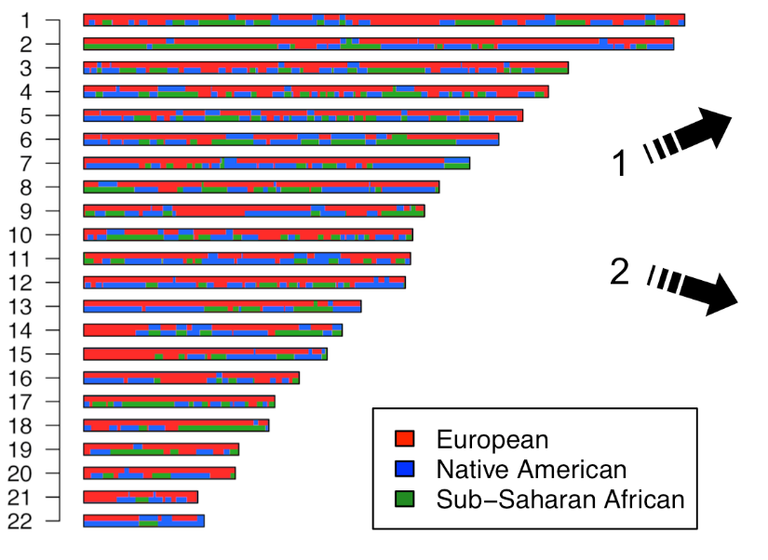
Local Ancestry through chromosome painting
Notes:
Number refers to a chromosome
Length
We order chromosomes by their lengths
This is for individual, admixture + PCA are for population
We can also zoom into a single person’s genome and look at their chromosomes. Using mathematical models we can predict which ancestral genome each part of the chromosome came from.
Here, each line corresponds to a chromosome and the colors indicate whether that part of the chromosome was inherited from a European, Native American, or Sub-Saharan African ancestral genome.

Slide 11

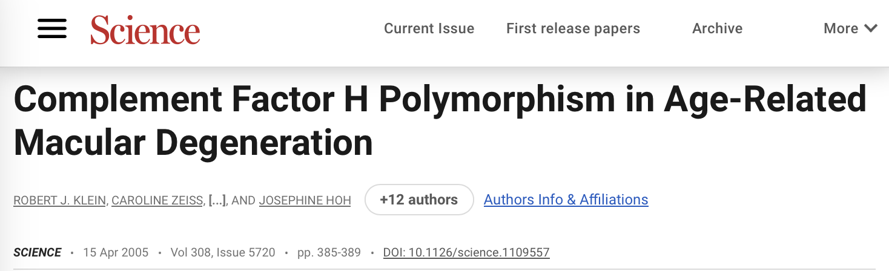
Population Genomics is useful in practice too
Notes:
And this population genomics isn’t just interesting socioa, it can also be used for:
Identifying criminals by DNA evidence, even if they haven’t given a DNA sample
Helping determine which genomic variations are responsible for many inherited diseases
Age-related macular degeneration is responsible for loss of vision in many elderly
Huntington’s disease
Sickle cell anemia
So many, many more

Slide 12
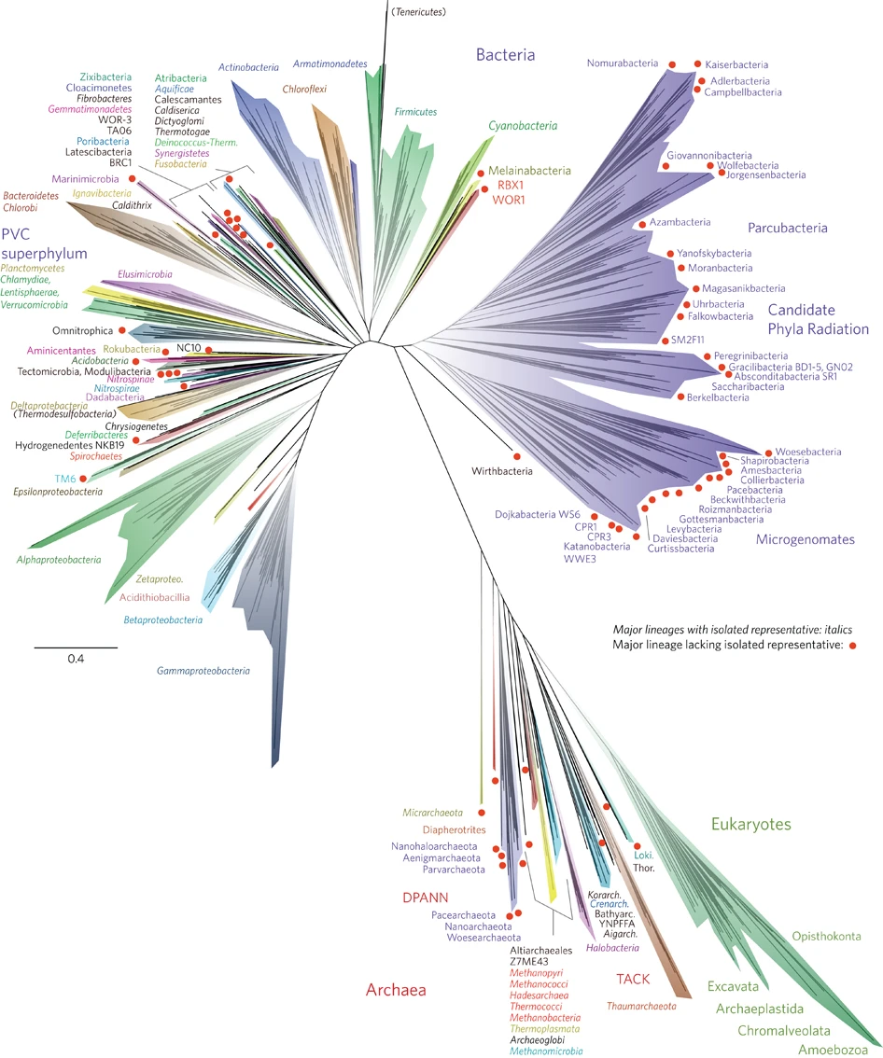
Phylogenetics
https://doi.org/10.1038/nmicrobiol.2016.48
Notes:
Current most updated phylogenetic tree that we have
Phylogenetics is how we try to understand how species evolved and how they relate to each other.
By looking at the DNA of species we can draw the complete “Tree of Life” (pictured here) in ways that before biologists could only infer by studying the physical characteristics of several species.
This is incredibly important for understanding how DNA actually codes for you and me which, despite everything we know, is still mostly an open question. Understanding that share some of the same DNA coding for different organs or types of cells in our bodies allows us to study these species to understand our own biology.

Slide 13
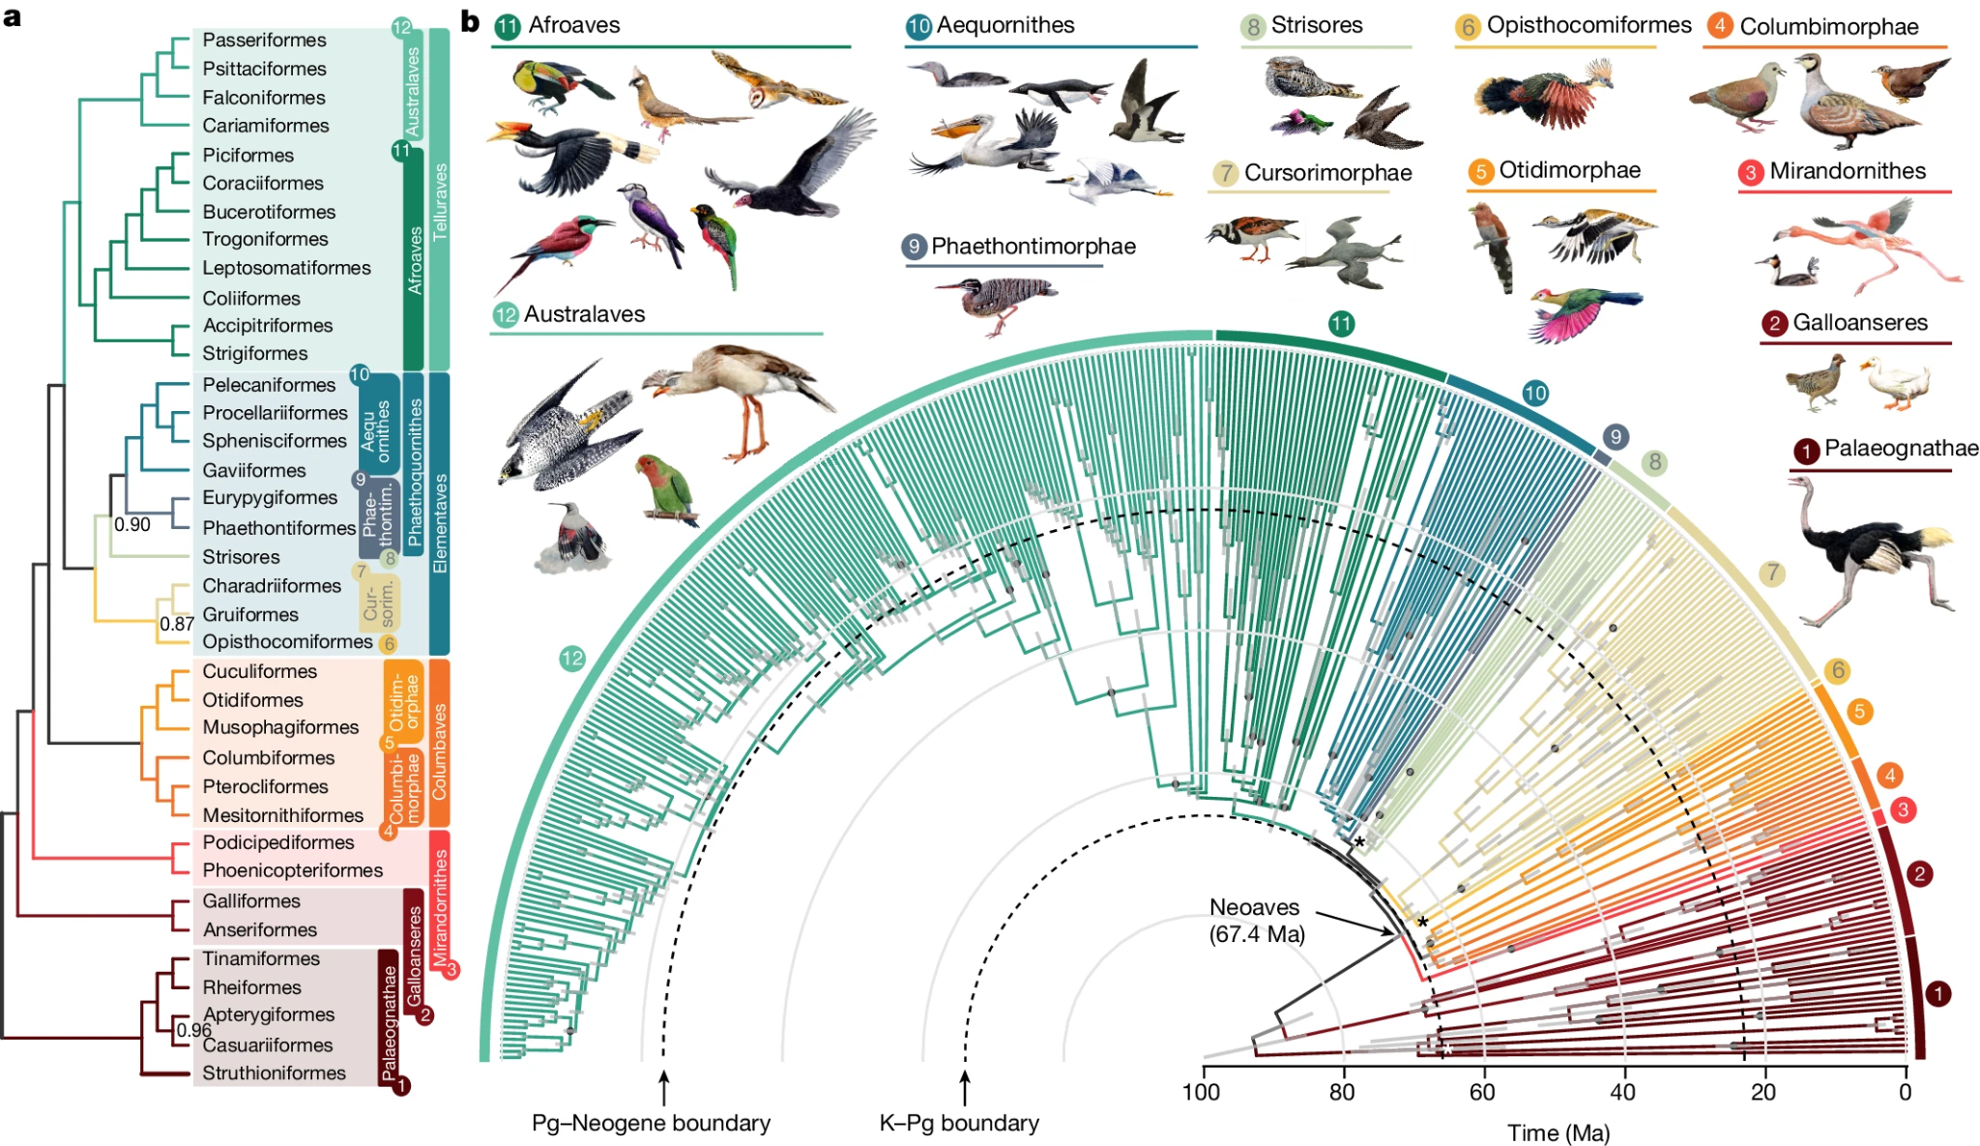
The phylogenetic tree of avians
https://doi.org/10.1038/nmicrobiol.2016.48
Notes:
This is a phylogenetic tree of birds.
For example, there is a type of neuron and neuron structure that only appears in songbirds that we think might be associated with their ability to “speak” and communicate using tones. A very similar neuronal configuration appears in humans but not in other great apes which might explain why humans can speak.
Figure – https://doi.org/10.1038/s41586-024-07323-1
Songbird brains – https://www.pnas.org/doi/full/10.1073/pnas.1207207109#:~:text=Songbirds%20have%20analogous%20brain%20regions,responsiveness%20in%20these%20brain%20regions.

Slide 14
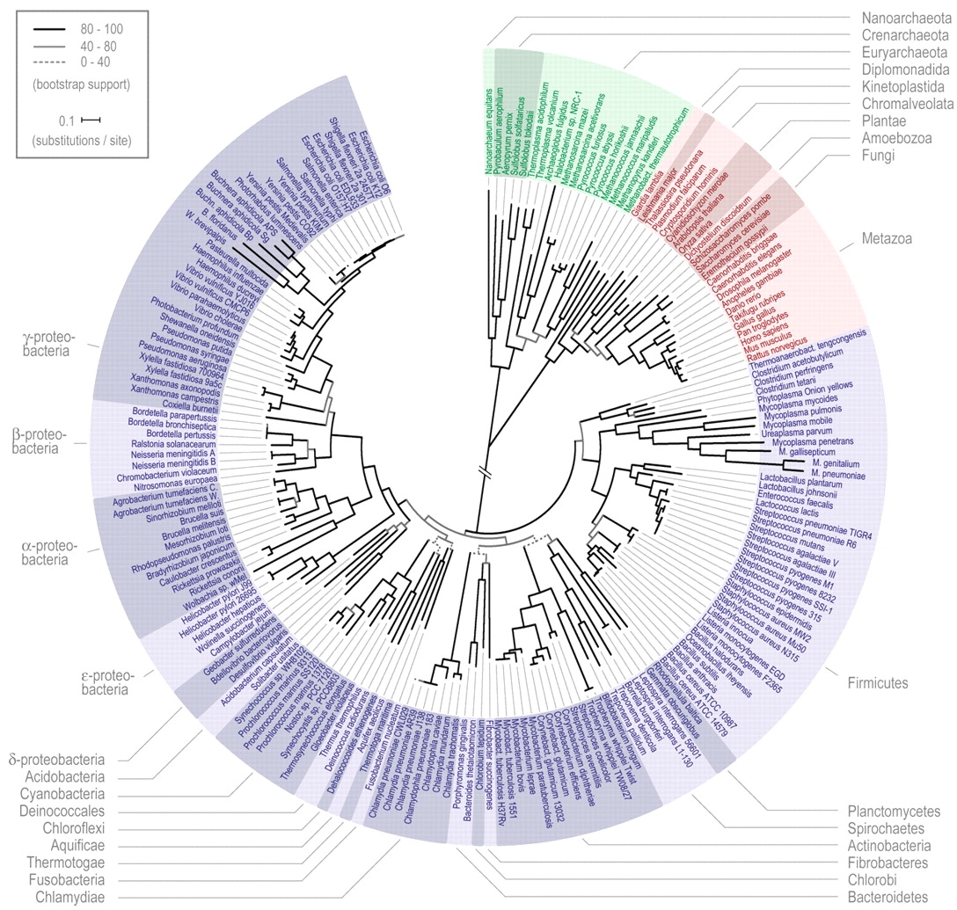
Modern sequencing scale revolutionized phylogenetics
2006 Version
2016 Version
Notes:
Over 10 years our ability to sequence multiple species DNA has improved dramatically and has continued to do so. There are still thousands of interesting relationships between species that can help us understand ourselves and the world left to discover through this kind of research.
Check out the Zoonomia project if you are interested in learning more about these examples.

Slide 15
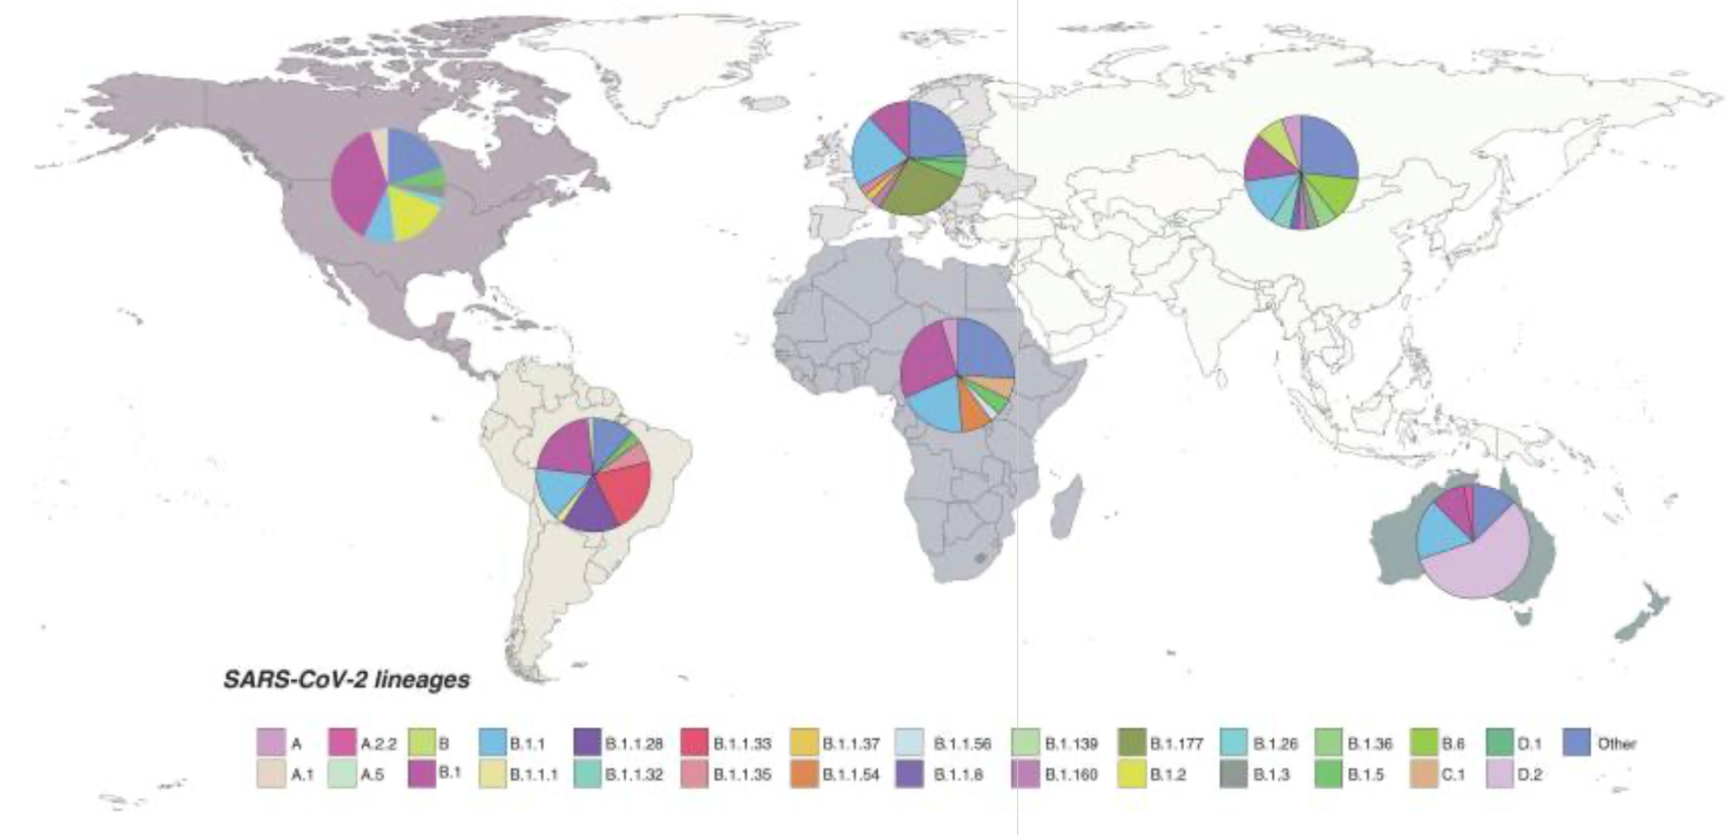
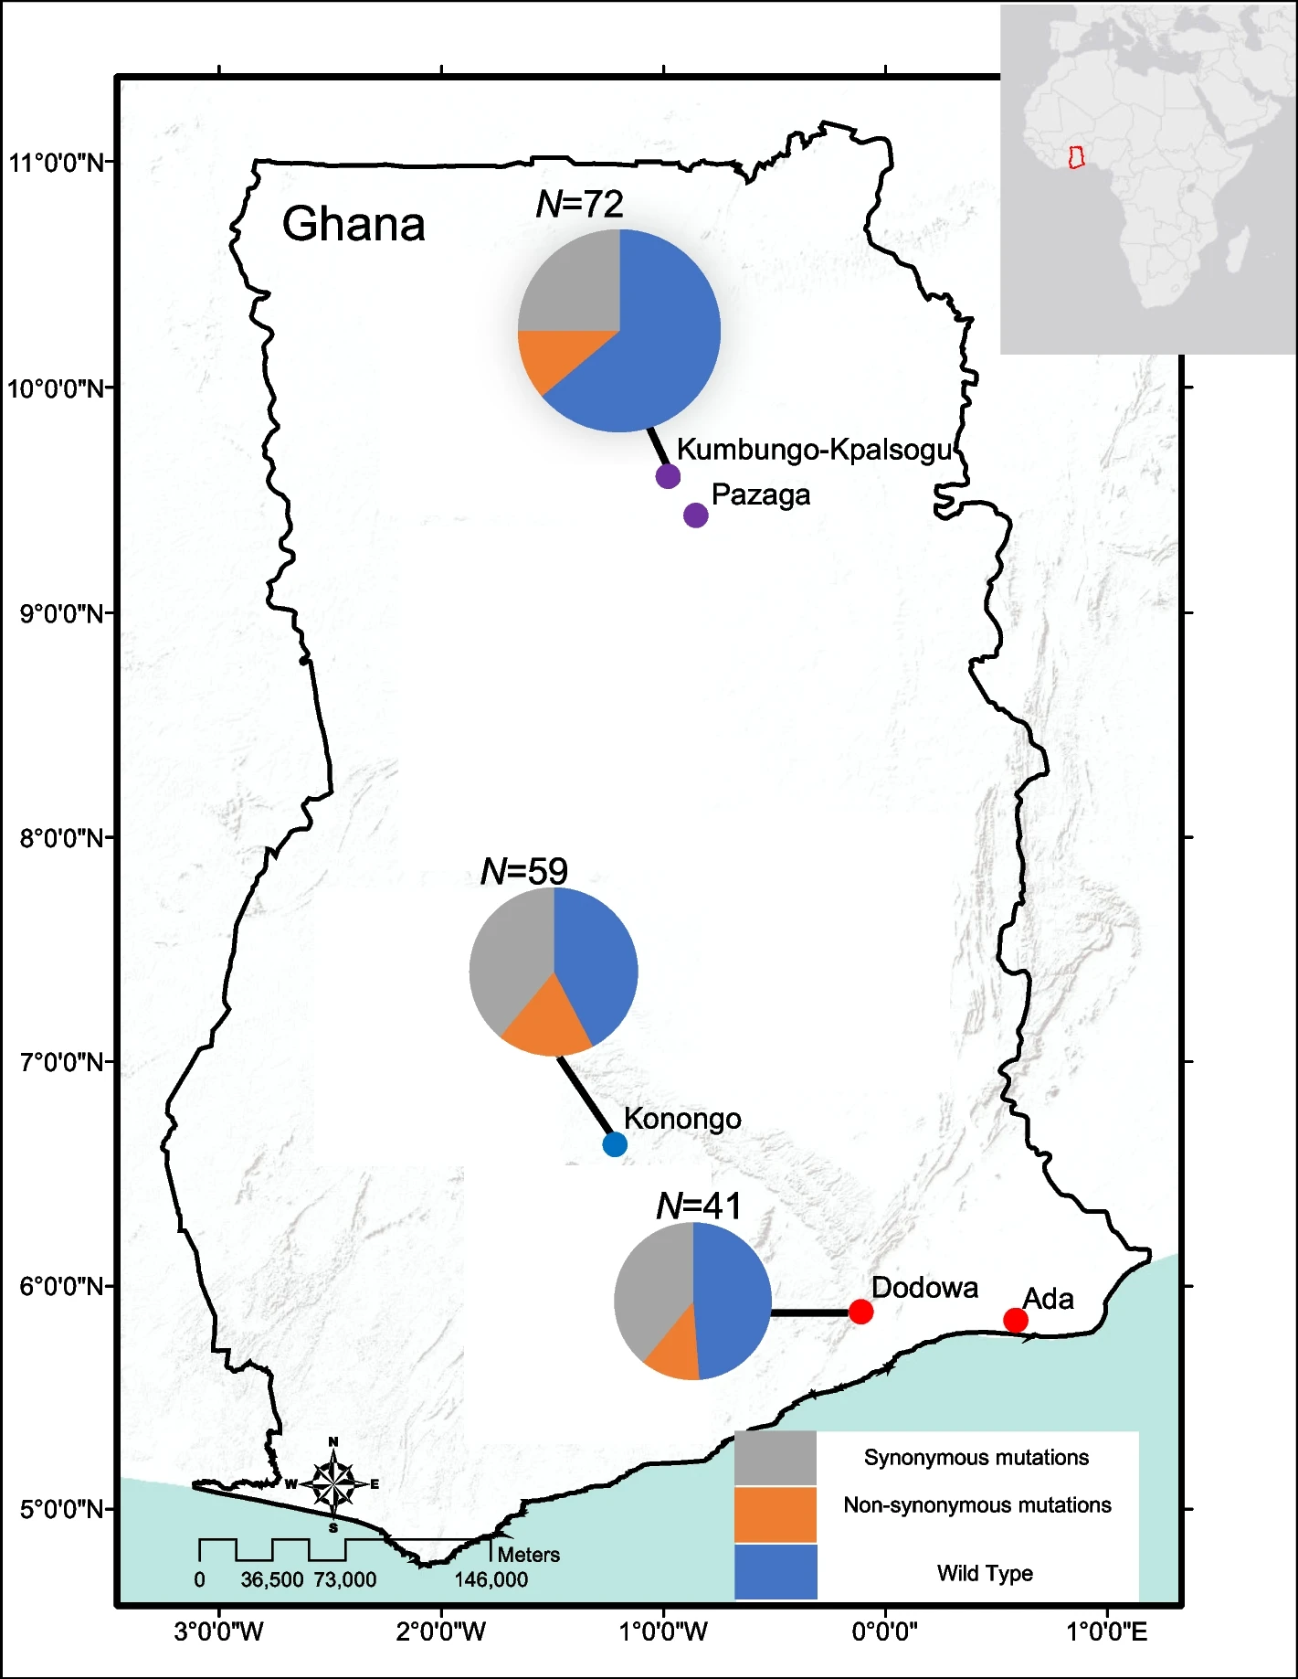
Phylogenetics plays a key role in public health
SARS Cov 2 Variant Map
Malaria Variant Map
Notes:
These phylogenetic trees on viruses can help us understand which variations are widespread and can be used to prioritize vaccine or test development and deployment.
And they can also be used to predict and prepare for pandemics in advance by watching for new variants before they have a chance to spread.
Malaria Figure – https://bmcinfectdis.biomedcentral.com/articles/10.1186/s12879-023-08812-w
COVID Figure – https://www.ncbi.nlm.nih.gov/pmc/articles/PMC8089399/

Slide 16
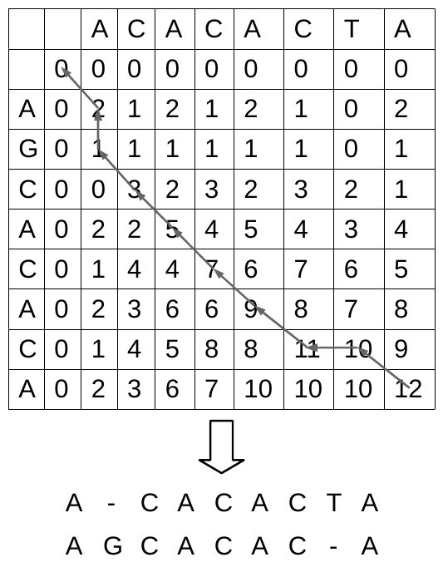
Omics Analysis
Notes:
Omics analysis is what most people think of when you say the word Bioinformatics. It’s a fundamental pre-processing step to take genomic sequences and turn them into the useful data that’s used for the analysis we’ve already covered and dozens of others.
Because it is so fundamental, most of your classes will cover the algorithmic basics of this step but in Workshop this year we want to introduce you to some of the other sides of Bioinformatics which you won’t hear as much about.
This is an example of the Smith-Waterman algorithm which you will learn about in CSE 181

Slide 17
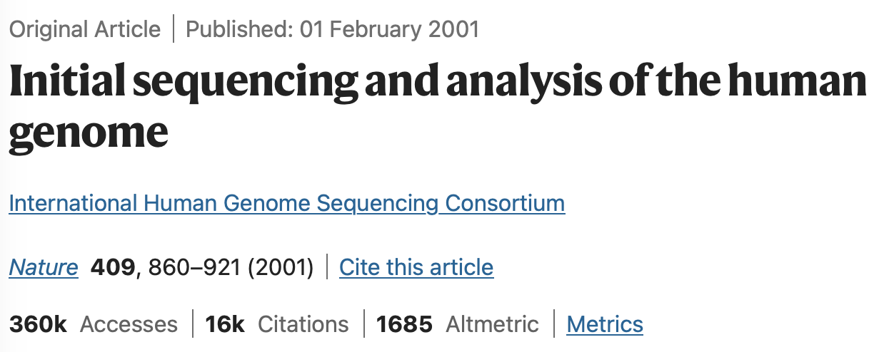
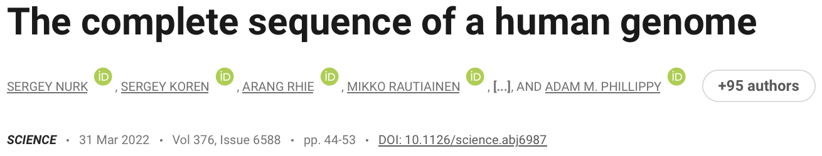
Bioinformatics begins with genome construction
Notes:
The human genome project
Cost about $3 billion
Took about 15 years
Still had many gaps
Not until 2022 did we get the first actual complete human genome. T2T.
Today a full human genome costs ~$500 and the kind used for ancestry analysis like in 23andMe is less than $100.
Sequencing is hard and there are many physical and computational challenges that had to be overcome to get to where we are now. You will learn about many of the algorithms required like alignment and genome constructions in your courses. So we won’t go into too much depth here.

Slide 18
Icebreaker
Would you rather?
Never take a chemistry or physics class again?
Be able to pick up any programming language or math really quickly?
Be in Revelle or ERC?
Notes:
Bad Question Ideas:
What were you doing on July 25th of this year?
2 Truths 1 Lie
What would you do with 1000 elephants?
Good Questions Ideas:
What classes are you taking this quarter?

Slide 19
What is UBIC’s Intro to Bioinformatics Workshop?
Biweekly workshops for you to learn more about bioinformatics
Designed for individuals with no previous experience
Lessons will not directly build on each other
Opportunity for you to meet other people interested in bioinformatics
Prepare for real-world projects
Fall Quarter will introduce you to different sides of bioinformatics
Future quarters may feature an ongoing project for your resume
Have fun and ask questions!
Notes:
Workshops are NOT continuous, so people don’t have to have come to the previous one

Slide 20
Fall Workshop Schedule
Alternating Tuesdays
@ 5:00-6:30 in Zweifach Library!
WEEK 4 (10/22)
WEEK 6
(11/5)
WEEK 8
(11/19)
WEEK 10 (12/3)
Omics and RNA-seq
Population Genetics
Fundamental Sequence Algorithms
Office Hours / Homework

Slide 21
Navigate to Google Colab on your Personal Devices…
it’s time for some Python

Slide 22
Python Introduction
Lesson Link
Variables
Print/ fstrings
Types
Arithmetic
Notes:
Students will create their own Google Colab Notebook
One person up at the front walking through these exercises / examples, everyone else wander

